Slide 1
Demystifying Computer Majors

Slide 2
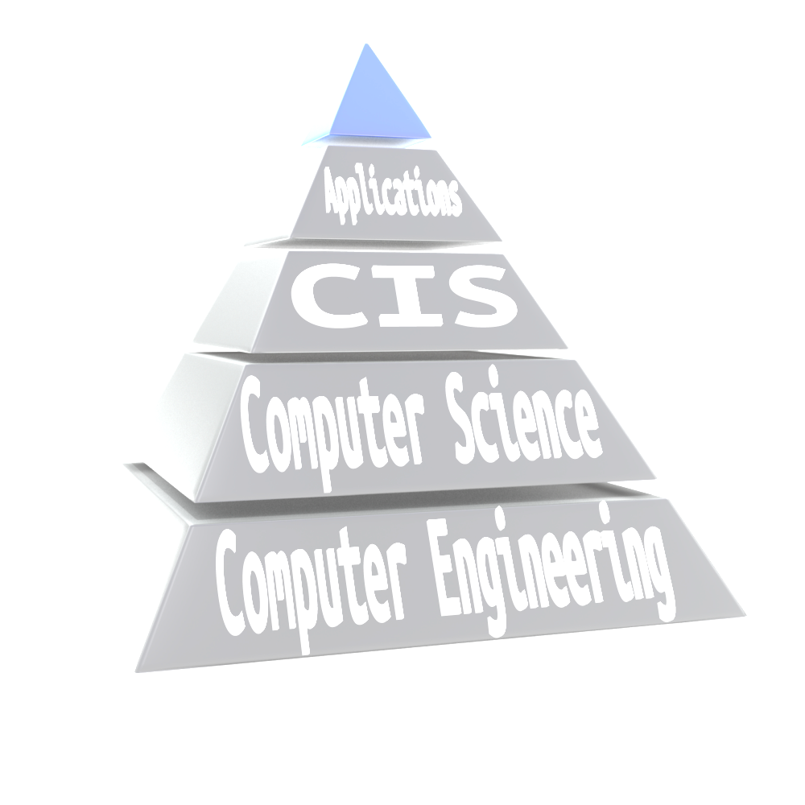
3 Computing Majors:
Computer Engineering
Computer Science
Computer Information Systems

Slide 3
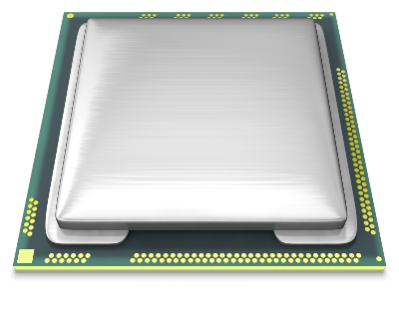
Hardware Related
With Some Programming

Slide 4
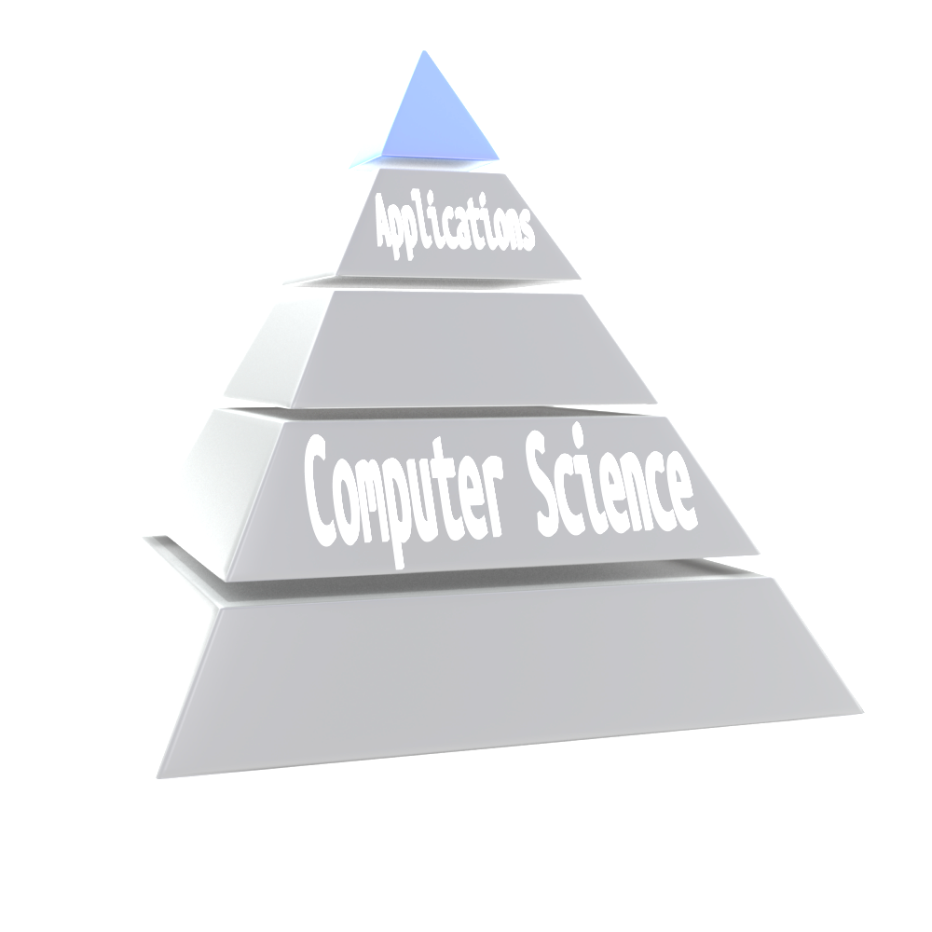
Programming to communicate with the hardware:
Operating Systems
Design and analyze algorithms to solve problems
Encryption
Study the performance of computer hardware and software

Slide 5
Create applications used by businesses and consumers
Major areas:
Programming
Systems Analysis and Design
Networking
Web Design
Cyber Security
Data Analytics

Slide 6
Resides in the College of Engineering
Math – Over 2 years
Physics – 1 year
Electrical Components – Too many to count

Slide 7
Resides in the College of Science
Calculus – 1 year
Physics – 1 year
Programming – 3 years

Slide 8
Resides in College of Business
Math – 1 year
Programming – 1 year
Business Classes – 2 to 3 years
Career Emphasis – 1 year

